Slide 1


Titolo presentazione sottotitolo
Fast Fourier Transform
Milano, XX mese 20XX
Advanced Methods for Scientific Computing
Broggini Emanuele – Ortenzi Andrea

Slide 2
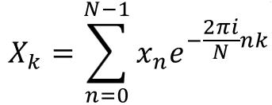
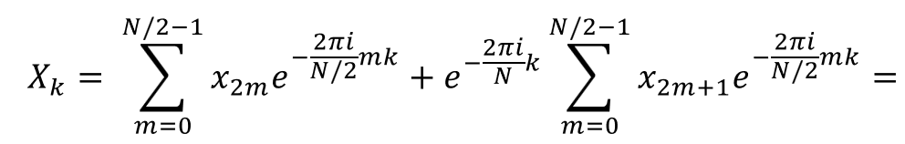
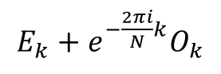
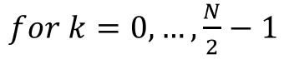
Cooley-Tukey Algorithm
DFT :
The algorithm implemented by Cooley and Tukey rearranges the DTF into two sums: one over the even numbered indices and one over the odd numbered ones.
Broggini Emanuele, Ortenzi Andrea

Slide 3
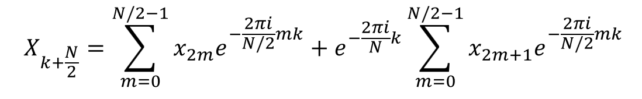
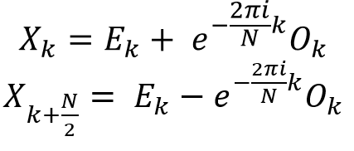
Thanks to the idempotent property and periodicity of complex esponential, we have that :
So, we get:
Broggini Emanuele, Ortenzi Andrea

Slide 4
FFT 1D
Broggini Emanuele, Ortenzi Andrea

Slide 5
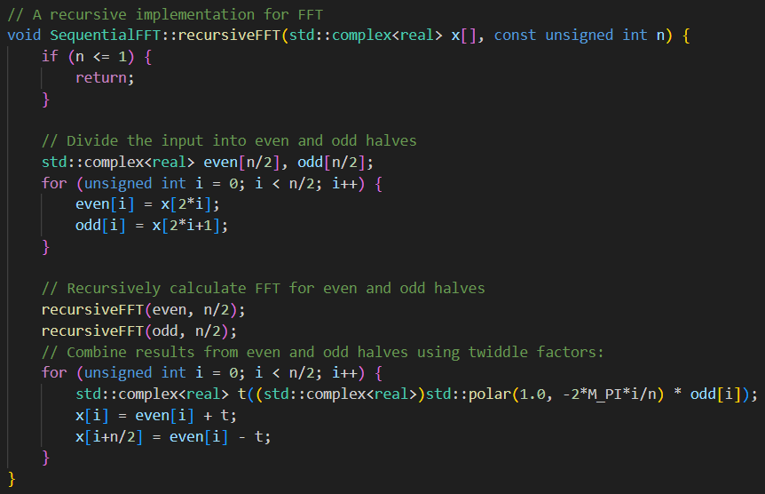
Recursive Algorithm
The recursive FFT divides the DFT calculation into smaller subproblems, making it significantly faster than the direct DFT computation.
This divide-and-conquer approach breaks down the problem into successively smaller DFTs until reaching the base case.
Then, it combines these smaller DFTs to obtain the final FFT result, achieving a remarkable reduction in computation time and complexity.
Here in picture our implementation:
Broggini Emanuele, Ortenzi Andrea

Slide 6
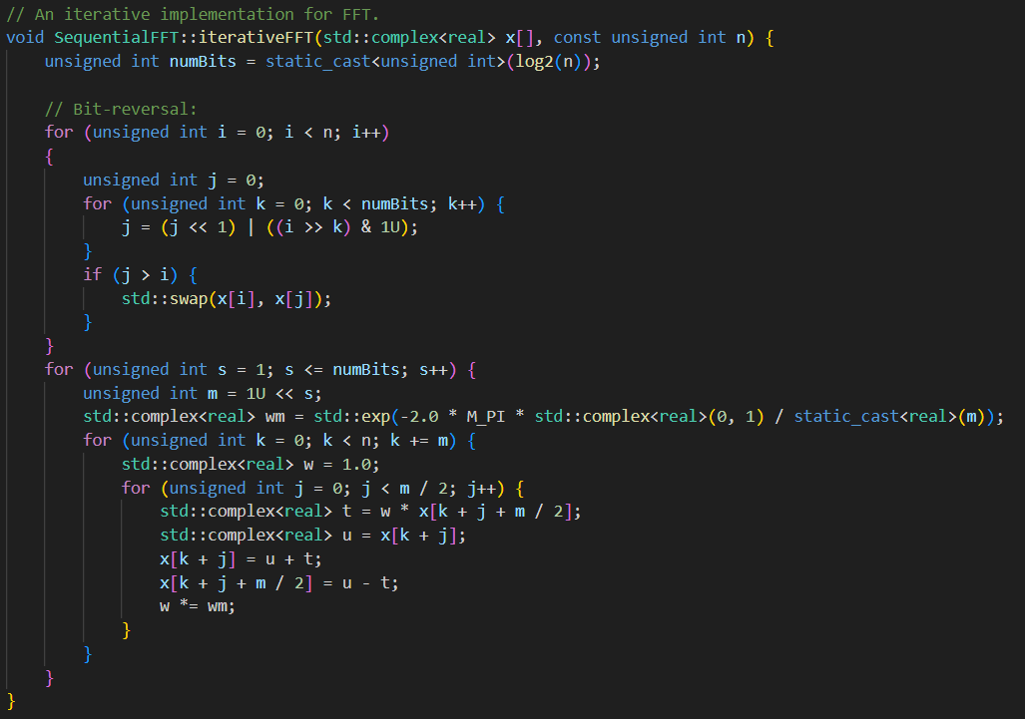
Iterative algorithm
Unlike the recursive FFT, which divides the problem into smaller subproblems, the iterative FFT employs a loop-based technique. It computes the DFT by iterating over the data, reordering it in a bit-reversed manner, and repeatedly applying butterfly operations.
Here in picture our implementation:
Broggini Emanuele, Ortenzi Andrea

Slide 7
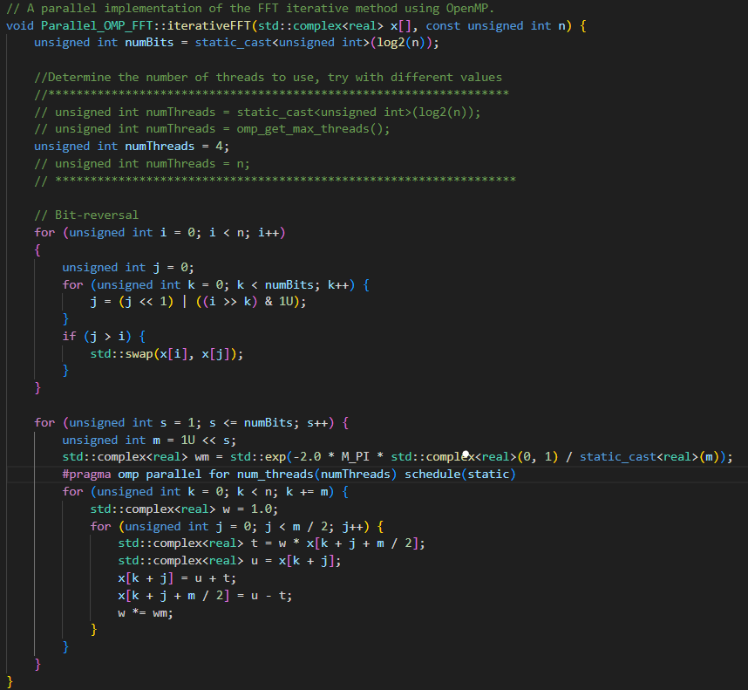
Parallel implementations OpenMP
In the iterative version after the bit-reversal,the algorithm subsequently divides the array into increasingly larger sections (2, 4, 8, ...) and computes the FFT on each section in parallel using the previously defined number of threads.
This takes place within the second for loop labeled with #pragma omp parallel for, which utilizes OpenMP to manage parallelism.
Parallel Butterfly Operation
Broggini Emanuele, Ortenzi Andrea

Slide 8
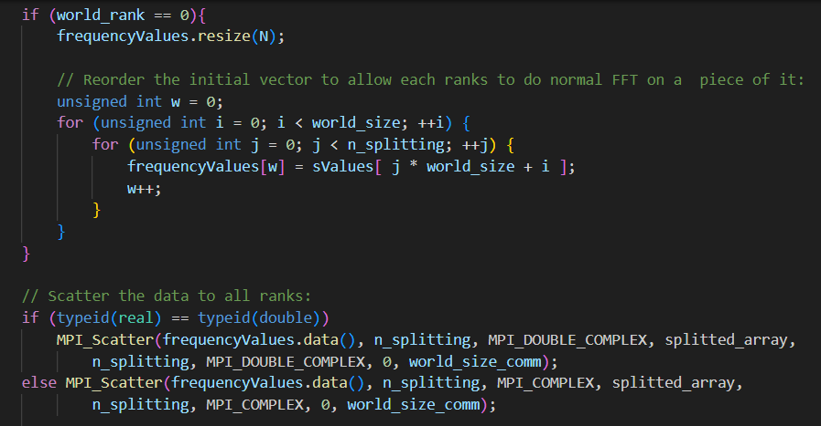
Parallel implementations MPI
1 | 2 | 3 | 4 | 5 | 6 | 7 | 8
1 | 5 | 2 | 6 | 3 | 7 | 4 | 8
Broggini Emanuele, Ortenzi Andrea

Slide 9
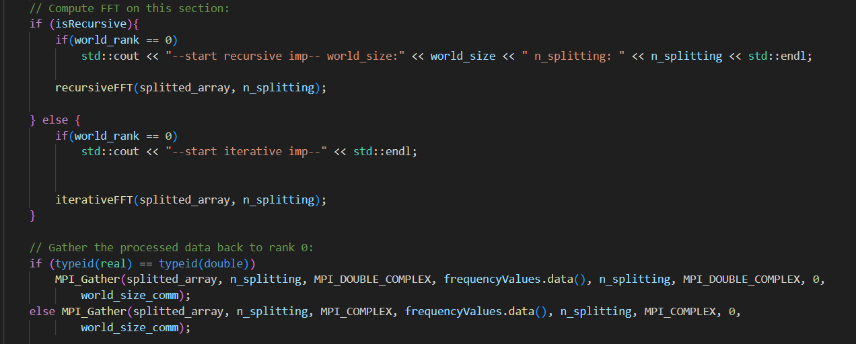
Parallel implementations MPI
1 | 5 | 2 | 6 | 3 | 7 | 4 | 8
FFT
Freq | Freq | Freq | Freq
Broggini Emanuele, Ortenzi Andrea

Slide 10
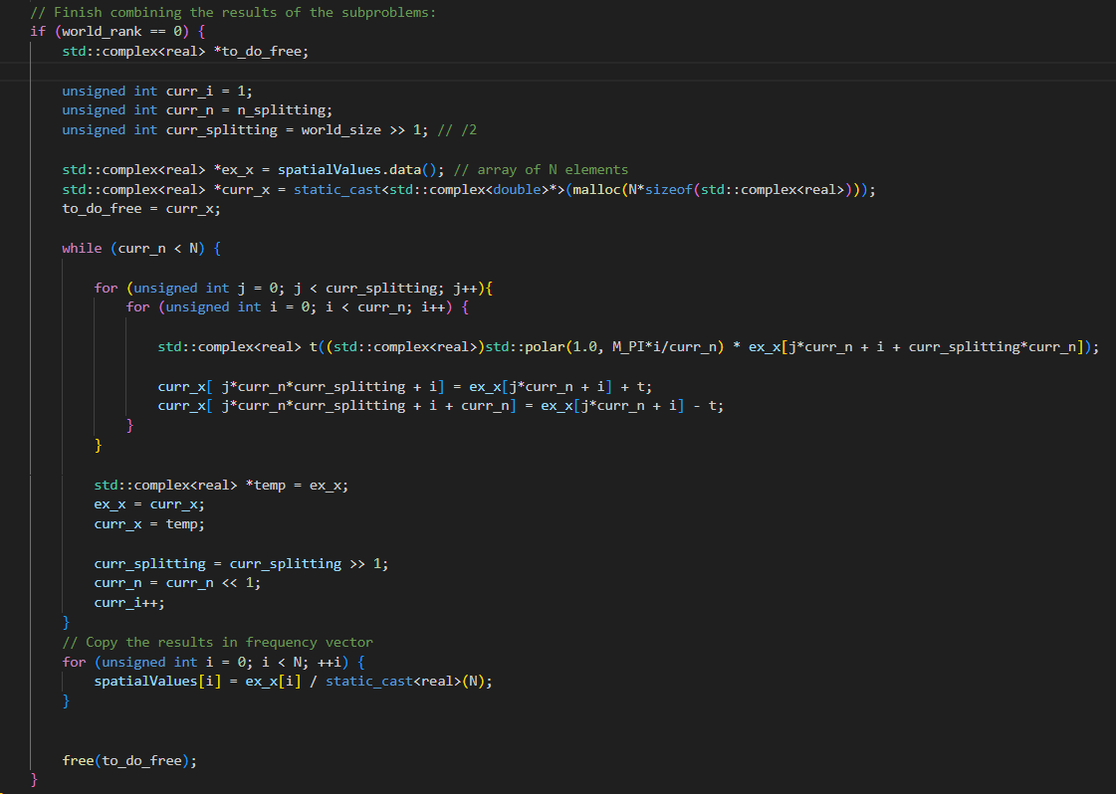
Parallel implementations MPI
Freq | Freq | Freq | Freq
Complete FFT
Frequency values
Broggini Emanuele, Ortenzi Andrea

Slide 11
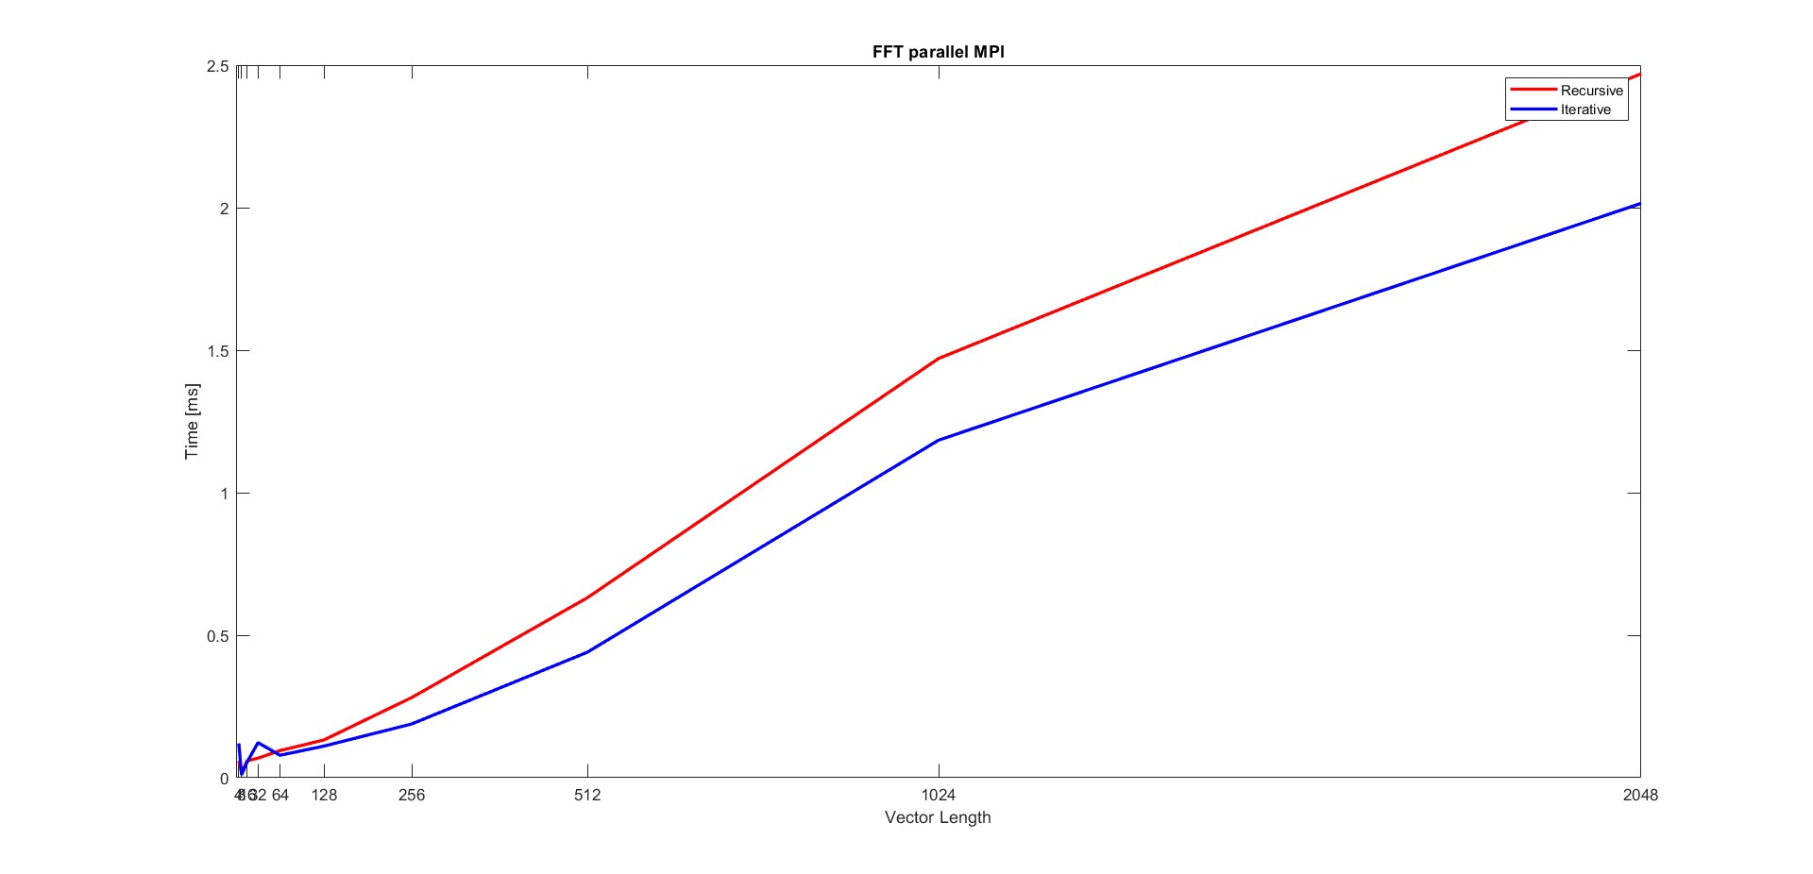
Parallel implementations MPI
Broggini Emanuele, Ortenzi Andrea

Slide 12
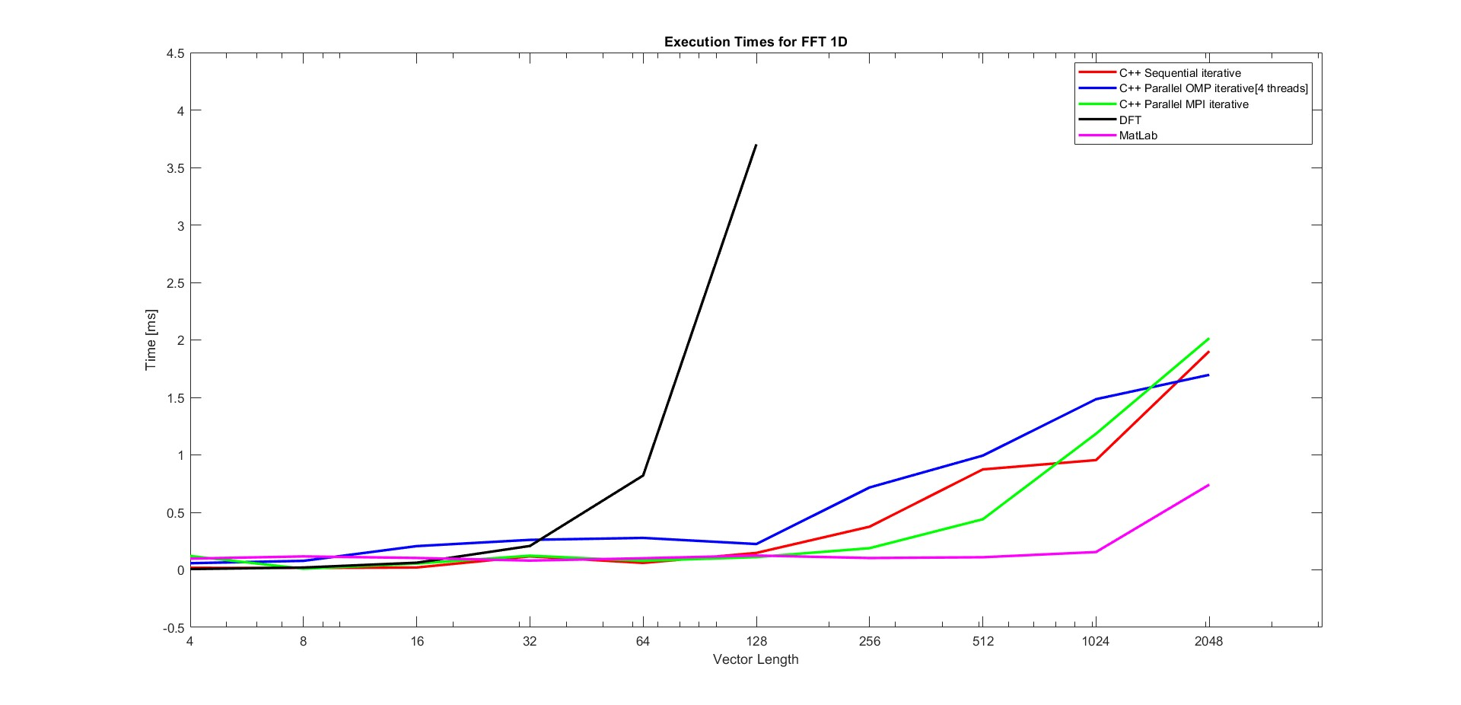
Some computational times for FFT1D
Broggini Emanuele, Ortenzi Andrea

Slide 13
FFT 2D
Broggini Emanuele, Ortenzi Andrea

Slide 14
FFT 2D
Iterative algortihm
We have utilized the FFT 1D iterative algorithm before on each rows of matrix and then on each columns.
We have implemented two versions and in the next slides we present the differences in computational times.
Eigen: more pratical
VecVec: more optimized, with reduced memory copies and memory sequential accesses
Broggini Emanuele, Ortenzi Andrea

Slide 15
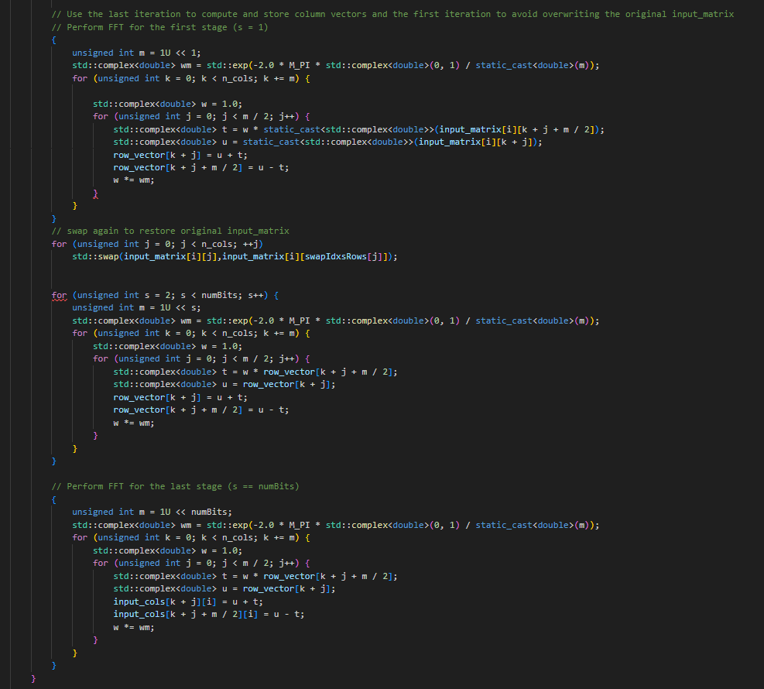
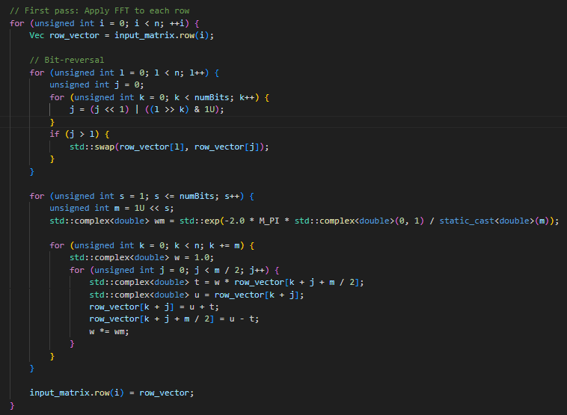
FFT2D VecVec
s = 1
1< s <numBits
s = numBits
Broggini Emanuele, Ortenzi Andrea

Slide 16
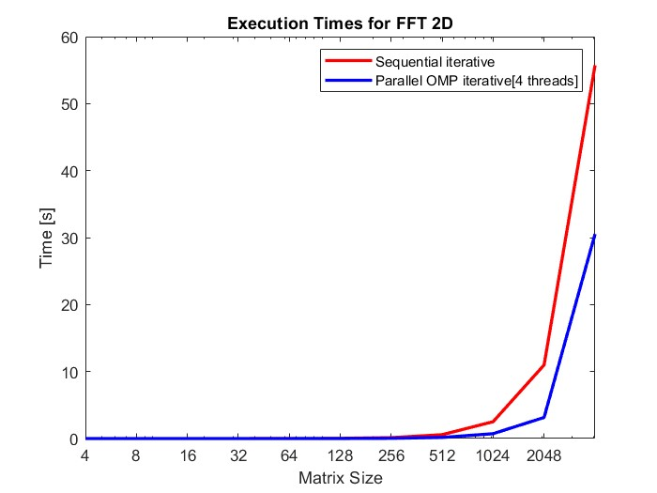
FFT 2D Eigen version
Broggini Emanuele, Ortenzi Andrea

Slide 17
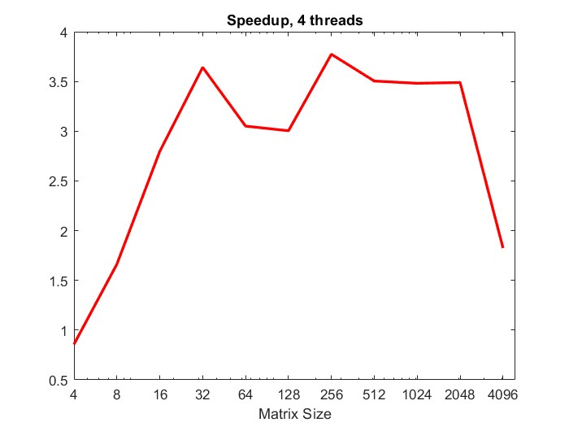
FFT 2D Eigen version
Broggini Emanuele, Ortenzi Andrea

Slide 18
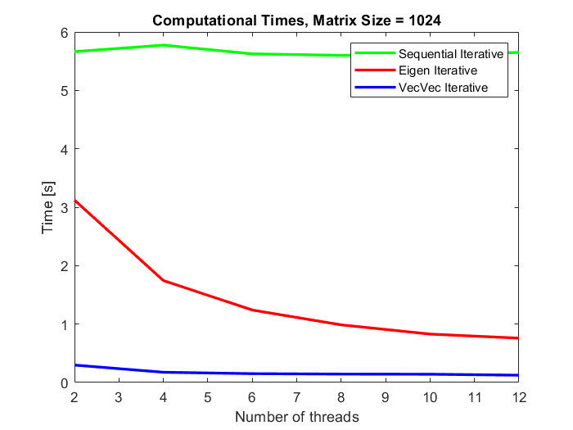
Comparison between Eigen and VecVec implementations
Broggini Emanuele, Ortenzi Andrea

Slide 19
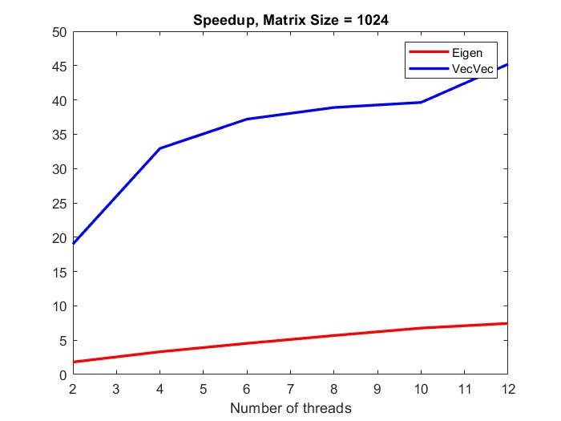
Comparison between Eigen and VecVec implementations
Broggini Emanuele, Ortenzi Andrea

Slide 20
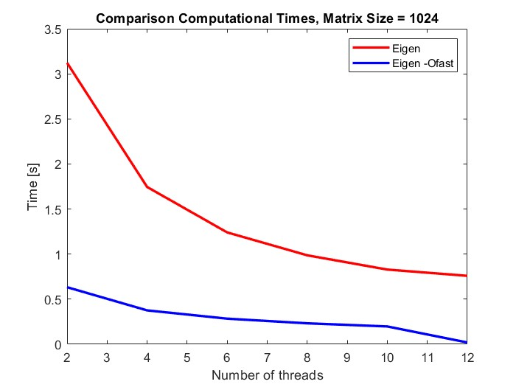
Compiler flags comparison
EIGEN
Broggini Emanuele, Ortenzi Andrea

Slide 21
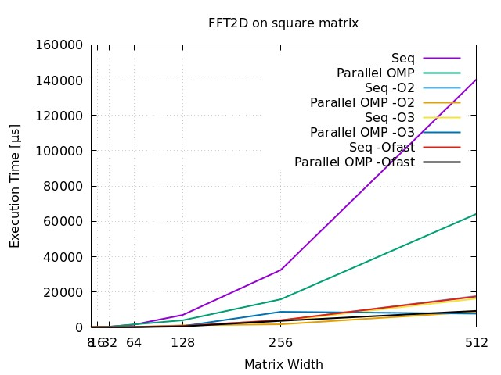
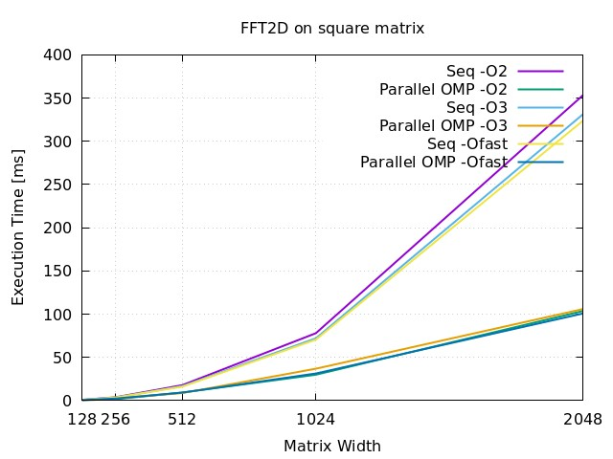
Compiler flags comparison
VECVEC
Broggini Emanuele, Ortenzi Andrea

Slide 22
VIDEO PROCESSING
Broggini Emanuele, Ortenzi Andrea

Slide 23
VIDEO PROCESSING
"Why don't we just apply our FFT to a video? It should be a series of images, isn't it?"
NO!
Broggini Emanuele, Ortenzi Andrea

Slide 24
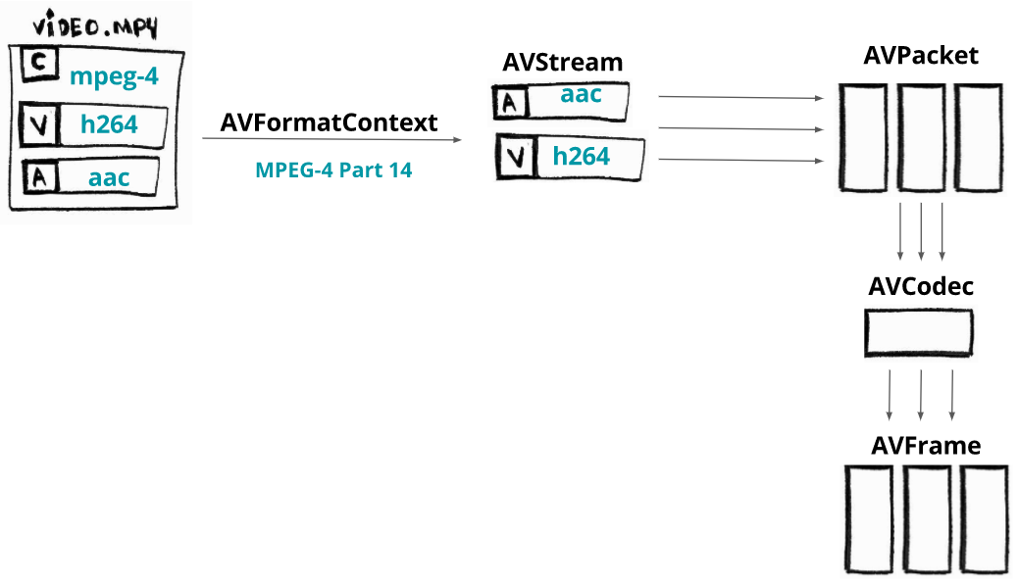
VIDEO PROCESSING
"Why don't we just apply our FFT to a video? It should be a series of images, isn't it?"
NO!
Broggini Emanuele, Ortenzi Andrea

Slide 25

VIDEO PROCESSING
"Why don't we just apply our FFT to a video? It should be a series of images, isn't it?"
NO!
Broggini Emanuele, Ortenzi Andrea

Slide 26
IMAGE PROCESSING
Broggini Emanuele, Ortenzi Andrea

Slide 27
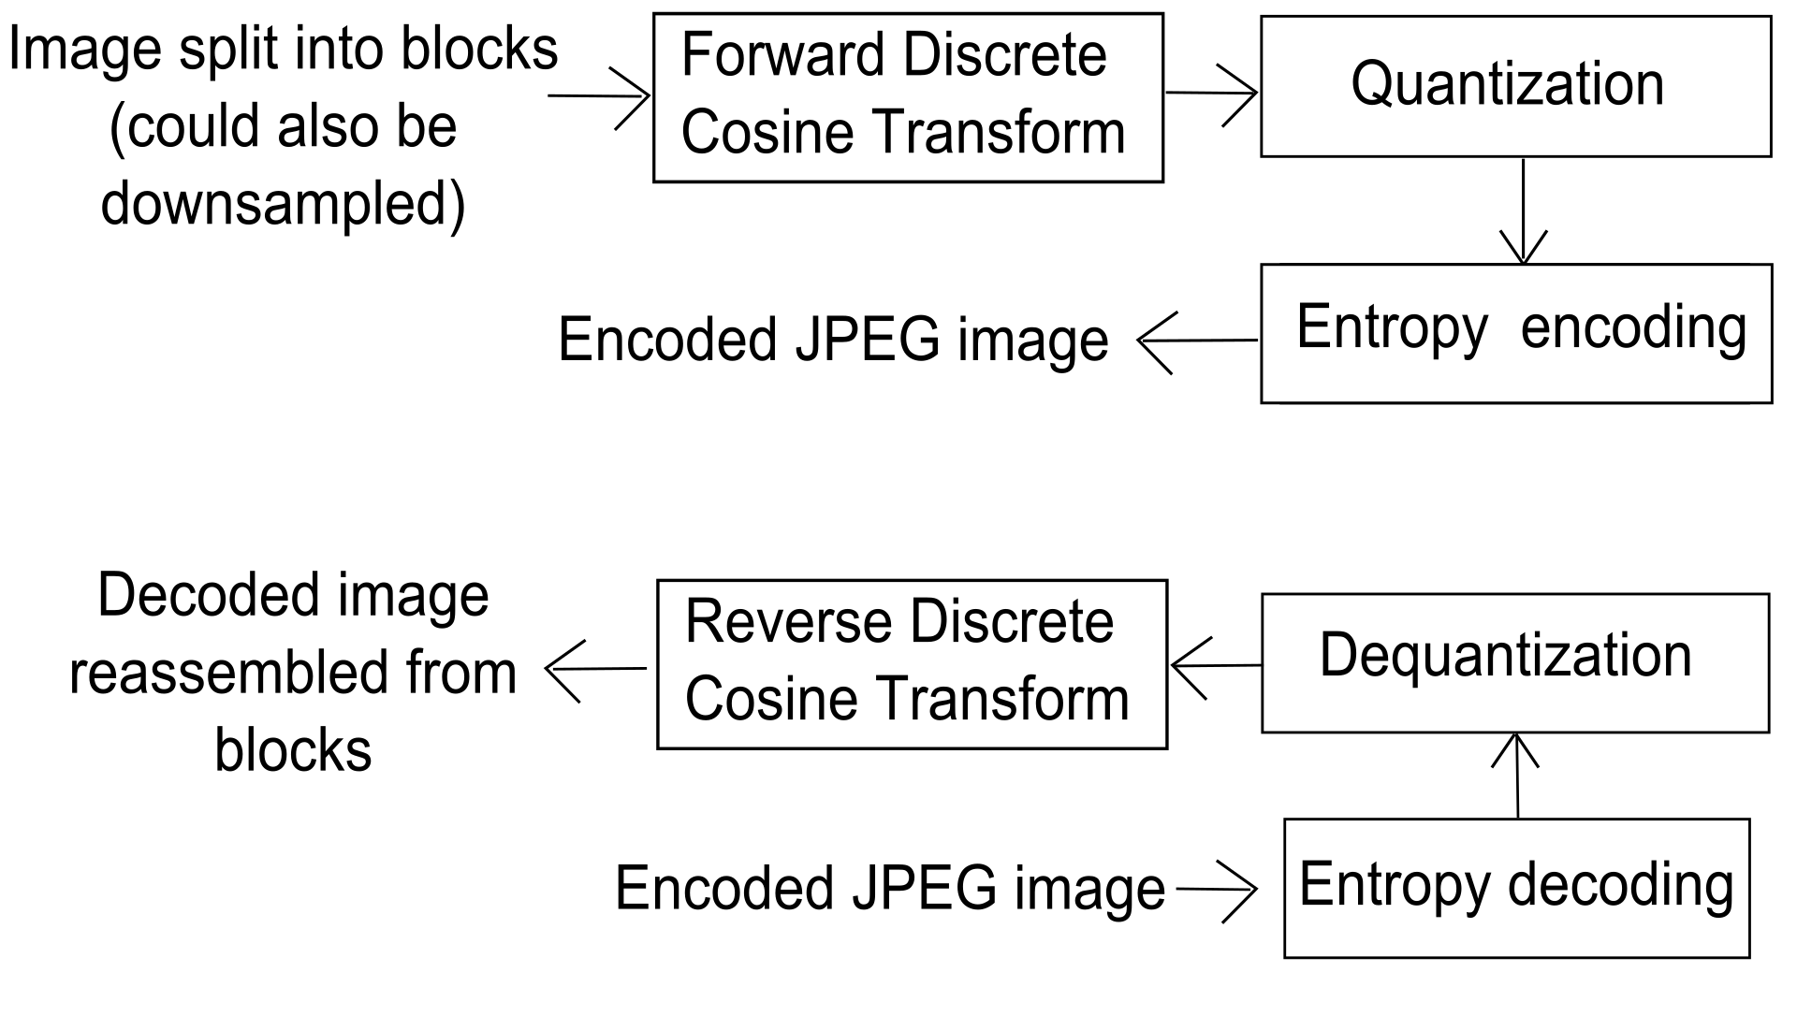
IMAGE PROCESSING
JPEG
Broggini Emanuele, Ortenzi Andrea

Slide 28
IMAGE PROCESSING
OUR TRANSFORMATION
iFFT
Image split into Minimum Coded Units (Square matrices with padding)
FFT
Quantization
Phase and norm matrices for each pixel channel
Data type approximation
Broggini Emanuele, Ortenzi Andrea

Slide 29
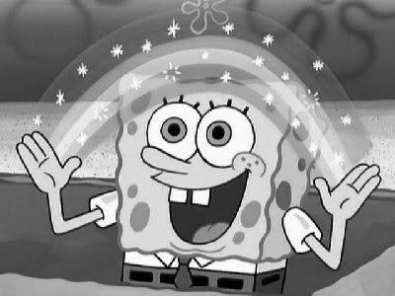

IMAGE PROCESSING
DATA APPROXIMATION
Original | Float | Int norm | Int phase
Imagemagick compare
Broggini Emanuele, Ortenzi Andrea

Slide 30
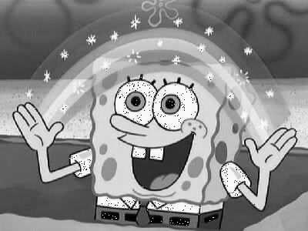
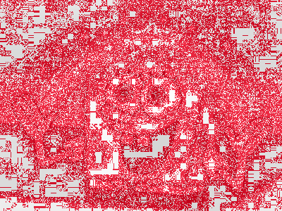
IMAGE PROCESSING
DATA APPROXIMATION
Original | Float | Int norm | Int phase
Imagemagick compare
Broggini Emanuele, Ortenzi Andrea

Slide 31

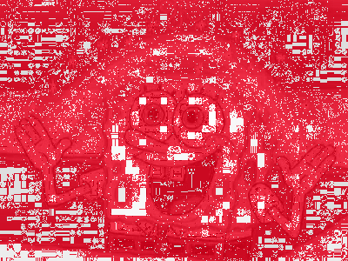
IMAGE PROCESSING
DATA APPROXIMATION
Original | Float | Int norm | Int phase
Imagemagick compare
Broggini Emanuele, Ortenzi Andrea

